Slide 1

Searching and Sorting Algorithms for Optimization
In this session, we will delve into the intricacies of searching and sorting algorithms and their vital role in optimization.
S. K. Verma

Slide 2

Understanding Time and Space Complexity
The goal of the analysis of algorithms is to compare algorithms (or solutions) mainly in terms of running time and/or memory but also in terms of other factors (e.g., developer effort, scalability, Adaptability, etc.)
Efficient algorithms save resources (time and memory)
Running Time Analysis?
It is the process of determining how processing time increases as the size of the problem (input size) increases. Input size is the number of elements in the input, and depending on the problem type, the input may be of different types.
The following are the common types of inputs.
• Size of an array
• Polynomial degree
• Number of elements in a matrix
• Number of bits in the binary representation of the input
• Vertices and edges in a graph.

Slide 3
Analysis of Algorithms
Running Time
Pseudo-Code
Analysis of Algorithms
Asymptotic Notation
Asymptotic Analysis
Mathematical facts
t

Slide 4
Average Case vs. Worst Case Running Time of an algorithm
An algorithm may run faster on certain data sets than on others.
Finding the average case can be very difficult, so typically algorithms are measured by the worst-case time complexity.
Also, in certain application domains (e.g., air traffic control, surgery, IP lookup) knowing the worst-case time complexity is of crucial importance.

Slide 5
Measuring the Running Time
How should we measure the running time of an algorithm?
Approach 1: Experimental Study
Write a program that implements the algorithm
Run the program with data sets of varying size and composition.
Use a method like System.currentTimeMillis() to get an accurate measure of the actual running time.

Slide 6
Beyond Experimental Studies
Experimental studies have several limitations:
It is necessary to implement and test the algorithm in order to determine its running time.
Experiments can be done only on a limited set of inputs, and may not be indicative of the running time on other inputs not included in the experiment.
In order to compare two algorithms, the same hardware and software environments should be used.

Slide 7
Understanding Time and Space Complexity
How to Compare Algorithms?
A few objective measures to be considered while comparing algorithms:
Execution times? Not a good measure as execution times are specific to a particular computer.
Number of statements executed? Not a good measure, since the number of statements varies with the programming language as well as the style of the individual programmer.
Feasible solution? Let us assume that we express the running time of a given algorithm as a function of the input size n (i.e., f(n)) and compare these different functions corresponding to running times. This kind of comparison is independent of machine time, programming style, etc.
Rate of Growth Asymptotic Analysis Amortized Analysis

Slide 8
Beyond Experimental Studies
We will now develop a general methodology for analyzing the running time of algorithms. In contrast to the "experimental approach", this methodology:
Uses a high-level description of the algorithm instead of testing one of its implementations.
Takes into account all possible inputs.
Allows one to evaluate the efficiency of any algorithm in a way that is independent from the hardware and software environment.

Slide 9
Pseudo-Code
Pseudo-code is a description of an algorithm that is more structured than usual prose but less formal than a programming language.
Example: finding the maximum element of an array.
Algorithm arrayMax(A, n):
Input: An array A storing n integers.
Output: The maximum element in A.
currentMax ← A[0]
for i← 1 to n -1 do
if currentMax < A[i] then currentMax ← A[i]
return currentMax
Pseudo-code is our preferred notation for describing algorithms.
However, pseudo-code hides program design issues.

Slide 10
What is Pseudo-Code ?
A mixture of natural language and high-level programming concepts that describes the main ideas behind a generic implementation of a data structure or algorithm.
-Expressions: use standard mathematical symbols to describe numeric and Boolean expressions -use ← for assignment (“=” in Java)
-use = for the equality relationship (“==” in Java)
-Method Declarations: -Algorithm name(param1, param2)
-Programming Constructs: - decision structures: if ... then ... [else ... ]
- while-loops: while ... do
- repeat-loops: repeat ... until ...
- for-loop: for ... do
- array indexing: A[i]
-Methods: - calls: object method(args)
- returns: return value

Slide 11
Analysis of Algorithms
Primitive Operations: Low-level computations independent from the programming language can be identified in pseudocode.
Examples:
calling a method and returning from a method
arithmetic operations (e.g. addition)
comparing two numbers, etc.
By inspecting the pseudo-code, we can count the number of primitive operations executed by an algorithm.

Slide 12
Example:
Algorithm arrayMax(A, n): Input: An array A storing n integers. Output: The maximum element in A. currentMax ¨ A[0] for i ¨ 1 to n -1 do if currentMax < A[i] then currentMax ← A[i] return currentMax

Slide 13
Asymptotic Notation
Goal: to simplify analysis by getting rid of unneeded information (like “rounding” 1,000,001≈1,000,000)
We want to say in a formal way 3n² ≈ n²
The “Big-Oh” Notation:
given functions f(n) and g(n), we say that f(n) is O(g(n) ) if and only if there are positive constants c and n₀ such that f(n)≤ c g(n) for n ≥ n₀

Slide 14
Example
For functions f(n) and g(n) (to the right) there are positive constants c and n₀ such that: f(n)≤c g(n) for n ≥ n₀
conclusion:
2n+6 is O(n).

Slide 15
Another Example
On the other hand…
n² is not O(n) because there is no c and n₀ such that:
n² ≤ cn for n ≥ n₀
(As the graph to the right illustrates, no matter how large a c is chosen there is an n big enough that n²>cn ) .

Slide 16
Asymptotic Notation (cont.)
Note: Even though it is correct to say “7n - 3 is O(n³)”, a better statement is “7n - 3 is O(n)”, that is, one should make the approximation as tight as possible
Simple Rule: Drop lower order terms and constant factors
7n-3 is O(n)
8n²log n + 5n² + n is O(n²log n)

Slide 17
Asymptotic Notation (terminology)
Special classes of algorithms:
Logarithmic : O(log n)
Linear : O(n)
Quadratic : O(n²)
Polynomial : O(n^{k}), k ≥ 1
Exponential : O(a^{n}), n > 1
“Relatives” of the Big-Oh
Ω (f(n)): Big Omega--asymptotic lower bound
Θ (f(n)): Big Theta--asymptotic tight bound

Slide 18
Asymptotic Analysis of The Running Time
Use the Big-Oh notation to express the number of primitive operations executed as a function of the input size.
For example, we say that the arrayMax algorithm runs in O(n) time.
Comparing the asymptotic running time
-an algorithm that runs in O(n) time is better than one that runs in O(n²) time
-similarly, O(log n) is better than O(n)
-hierarchy of functions: log n << n << n² << n³ << 2n
Caution! Beware of very large constant factors. An algorithm running in time 1,000,000 n is still O(n) but might be less efficient on your data set than one running in time 2n², which is O(n²)

Slide 19
Example
Algorithm prefixAverages2(X):
Input: An n-element array X of numbers.
Output: An n -element array A of numbers such that A[i] is the average of elements X[0], ... , X[i].
Let A be an array of n numbers.
s← 0
for i ← 0 to n do
s ← s + X[i]
A[i] ← s/(i+ 1)
return array A
Analysis ...

Slide 20
Math You Need to Review
properties of logarithms:
log_{b}(xy) = log_{b}x + log_{b}y
log_{b} (x/y) = log_{b}x - log_{b}y
log_{b}xa = alog_{b}x
log_{b}a= log_{x}a/log_{x}b
properties of exponentials:
a^{(b+c)} = a^{b}a ^{c}
a^{bc} = (a^{b})^{c}
a^{b} /a^{c} = a^{(b-c)}
b = a ^{log}_{a}^{b}
b^{c} = a ^{c*log}_{a}^{b}
Floor: ⎣x⎦ = the largest integer ≤ x
Ceiling: ⎡x⎤ = the smallest integer ≥ x
Summations: (see Appendix A, p.619)
Geometric progression: (see Appendix A, p.620)

Slide 21
General rules to help us determine the running time of an algorithm.
Loops:
for( i=1; i<=n; i++) //Executes n times
sum=sum+2; //const time
Total Time = cxn → O(n)
Nested Loops:
for( i=1; i<=n; i++) //Outer loop Executes n times
for( j=1; j<=n; j++) //Executes n times
sum=sum+2; //const time
Total Time = cxnxn → O(n²)
Consecutive Statements:
K = k-1; //Constant time
for( i=1; i<=n; i++) //Executes n times
sum=sum+2; //constant time
for( i=1; i<=n; i++) //Out..loop Exe.. n times
for( j=1; j<=n; j++) //Executes n times
m=m-2; //const time
Total Time = c1 + c2xn + c3xnxn → O(n²)
If-then-else:
If(length()==0) //constant time
return false; //constant time
else{
for(int n=0; n<lengt(); n++) //Executes n times
if( !Arr[n].equals(Arr2[n])) //constant time
return false; //constant time
}
Total Time = c1+ c2 + (c3+c4)xn → O(n)
Logarithmic:
for( i=1; i<=n; )
i=i*2; 2,4,8,…→ 2^{n} = m
Total Time = O(log m)
Logarithmic:
for( i=n; i>=1; )
i=i/2;
Total Time = O(log m)

Slide 22
GATE CSE 2024 Set 1
Given an integer array of size 𝑁, we want to check if the array is sorted (in either ascending or descending order). An algorithm solves this problem by making a single pass through the array and comparing each element of the array only with its adjacent elements. The worst-case time complexity of this algorithm is
both O(N) and Ω(N)
O(N) but not Ω(N)
Ω(N) but not O(N)
neither O(N) nor Ω(N)

Slide 23
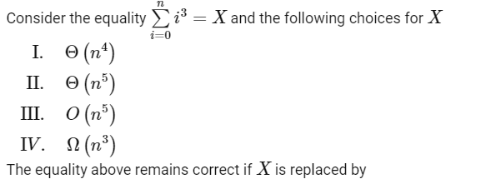
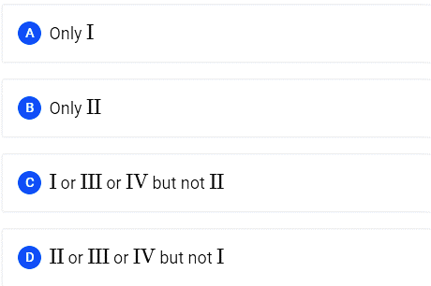
GATE CSE 2015 Set 3

Slide 24
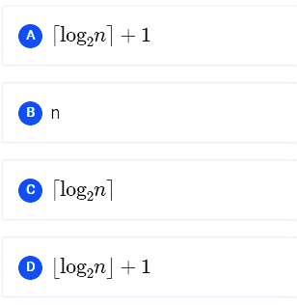
GATE CSE 2007
Consider the following segment of C-code:
int j, n;
j=1;
while(j <= n)
j = j * 2;
The number of comparisons made in the execution of the loop for any n > 0 is:

Slide 25
Overview of Searching Algorithms
1
Importance of Searching
Searching is fundamental to retrieving information from vast datasets
Vital for decision-making processes, aiding in data analysis and problem-solving.
Access to relevant data, reducing time and effort.
Real-world Examples
Web Search Engines
Database Queries
E-commerce Platforms

Slide 26
Linear Search Algorithms
2
Linear Search
Linear Search, also known as Sequential Search
Iterating through each element to find the target value
Worst CaseTime Complexity O(n)
Algorithm Steps:
Start from the beginning of the list.
Compare each element with the target value.
If a match is found, return the index.
If the end of the list is reached without finding a match, return a specified value (e.g., -1).
Optimal Scenario:
Small Datasets
Unordered Lists
First Occurrence Search
Disadvantages:
Inefficiency for Large Datasets
Not Suitable for Complex Data Structures
Limited Optimization Opportunities

Slide 27
3
Binary Search
Binary search is a powerful algorithm used for searching in a sorted collection (array, list, etc.).
It follows the principle of divide and conquer.
Time Complexity O(log₂ n)
Algorithm Steps:
Initialize as set LB = 0, UB = N - 1 and MID = (LB + UB)/2
Repeat the step 3 and 4 while {(LB<UB) and ARR [MID]≠NUM}
If (NUM < ARR[MID])
set UB = MID – 1
else set LB = MID + 1
Set MID = int {(LB + UB)/2}
If (ARR[MID] = NUM) then
Data found at MID index
else
Data not found.
Exit
Disadvantage:
A binary search comes with the prerequisite that the data must be sorted (Only Disadvantage)

Slide 28
is it correct method to find mid in Binary Search?
No, computing the midpoint (mid) in binary search can result in overflow if not handled carefully, especially when dealing with large arrays or extreme values.
The typical way to calculate the midpoint is using the formula (low + high) / 2. However, this can lead to overflow if low and high are both large integers.
It's crucial to be aware of the limitations of integer arithmetic and handle potential overflow issues, especially in languages where integer overflow may result in undefined behavior. Using larger data types (e.g., long long in C++ or long in Java)
int binarySearch(int arr[], int low, int high, int target) {
while (low <= high) {
int mid = low + (high - low) / 2; // Potential overflow
if (arr[mid] == target) {
return mid;
} else if (arr[mid] < target) {
low = mid + 1;
} else {
high = mid - 1;
}
}
return -1; // Element not found
}
low+(high-low)>>1 //Optimization

Slide 29
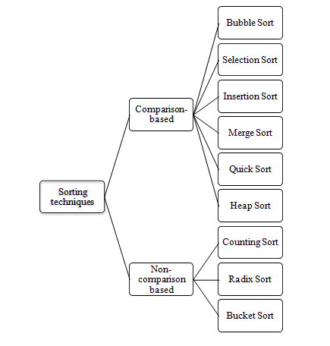
Key Sorting Algorithms
Sorting is the process of arranging data in a particular order which can either be ascending or descending.
Sorting Criteria:
Internal vs External Sorting
Stable vs Unstable Sorting
In-place vs Out-place Sorting

Slide 30
Selection Sort
void selectionSort(int arr[], int n)
{
int i, j, min_idx;
// One by one move boundary of unsorted subarray
for (i = 0; i < n-1; i++)
{
// Find the minimum element in unsorted array
min_idx = i;
for (j = i+1; j < n; j++)
if (arr[j] < arr[min_idx])
min_idx = j;
// Swap the found minimum element with the first element
if(min_idx != i)
swap(&arr[min_idx], &arr[i]);
}
}

Slide 31
Bubble Sort
void bubbleSort(int arr[], int n)
{
int i, j;
bool swapped;
for (i = 0; i < n - 1; i++) {
swapped = false;
for (j = 0; j < n - i - 1; j++) {
if (arr[j] > arr[j + 1]) {
swap(&arr[j], &arr[j + 1]);
swapped = true;
}
}
// If no two elements were swapped by inner loop,
// then break
if (swapped == false)
break;
}
}

Slide 32
Insertion Sort
void insertionSort(int arr[], int n)
{
int i, key, j;
for (i = 1; i < n; i++) {
key = arr[i];
j = i - 1;
/* Move elements of arr[0..i-1], that are
greater than key, to one position ahead
of their current position */
while (j >= 0 && arr[j] > key) {
arr[j + 1] = arr[j];
j = j - 1;
}
arr[j + 1] = key;
}
}

Slide 33
Counting Sort
int[] countSort(int[] inputArray) {
int N = inputArray.length;
int M = 0;
for (int i = 0; i < N; i++) {
M = Math.max(M, inputArray[i]);
}
int[] countArray = new int[M + 1];
for (int i = 0; i < N; i++) {
countArray[inputArray[i]]++;
}
for (int i = 1; i <= M; i++) {
countArray[i] += countArray[i - 1];
}
int[] outputArray = new int[N];
for (int i = N - 1; i >= 0; i--) {
outputArray[countArray[inputArray[i]] - 1] = inputArray[i];
countArray[inputArray[i]]--;
}
return outputArray;
}

Slide 34
Quick Sort

Slide 35
Quick Sort
int partition(int arr[], int low, int high)
{
// choose the pivot
int pivot = arr[high];
// Index of smaller element and Indicate
// the right position of pivot found so far
int i = (low - 1);
for (int j = low; j <= high - 1; j++) {
// If current element is smaller than the pivot
if (arr[j] < pivot) {
// Increment index of smaller element
i++;
swap(&arr[i], &arr[j]);
}
}
swap(&arr[i + 1], &arr[high]);
return (i + 1);
}
// The Quicksort function Implement
void quickSort(int arr[], int low, int high)
{
// when low is less than high
if (low < high) {
// pi is the partition return index of pivot
int pi = partition(arr, low, high);
// Recursion Call, smaller element than pivot goes left and
// higher element goes right
quickSort(arr, low, pi - 1);
quickSort(arr, pi + 1, high);
}
}

Slide 36
Merge Sort

Slide 37
void merge(int arr[], int l, int m, int r)
{
int i, j, k, n1 = m - l + 1;
int n2 = r - m;
int L[n1], R[n2]; //temp array
// Copy data to temp arrays L[] and R[]
for (i = 0; i < n1; i++)
L[i] = arr[l + i];
for (j = 0; j < n2; j++)
R[j] = arr[m + 1 + j];
// Merge the temp arrays back into arr[l..r
i = 0; j = 0; k = l;
while (i < n1 && j < n2) {
if (L[i] <= R[j]) {
arr[k] = L[i];
i++;
}
else {
arr[k] = R[j];
j++;
}
k++;
}
// Copy the remaining elements of L[], if there are any
while (i < n1) {
arr[k] = L[i];
i++;
k++;
}
// Copy the remaining elements of R[], if there are any
while (j < n2) {
arr[k] = R[j];
j++;
k++;
}
}
void mergeSort(int arr[], int l, int r)
{
if (l < r) {
int m = l + (r - l) / 2;
// Sort first and second halves
mergeSort(arr, l, m);
mergeSort(arr, m + 1, r);
merge(arr, l, m, r);
}
}
Merge Sort

Slide 38
Heap Sort

Slide 39
Heap Sort
void heapify(int arr[], int N, int i)
{
// Find largest among root, left child and right child
// Initialize largest as root
int largest = i;
int left = 2 * i + 1;
int right = 2 * i + 2;
// If left child is larger than root
if (left < N && arr[left] > arr[largest])
largest = left;
// If right child is larger than largest so far
if (right < N && arr[right] > arr[largest])
largest = right;
// Swap and continue heapifying if root is not largest
// If largest is not root
if (largest != i) {
swap(&arr[i], &arr[largest]);
// Recursively heapify the affected
// sub-tree
heapify(arr, N, largest);
}
}
// Main function to do heap sort
void heapSort(int arr[], int N)
{
// Build max heap
for (int i = N / 2 - 1; i >= 0; i--)
heapify(arr, N, i);
// Heap sort
for (int i = N - 1; i >= 0; i--) {
swap(&arr[0], &arr[i]);
// Heapify root element
// to get highest element at
// root again
heapify(arr, i, 0);
}
}

Slide 40
Sorting Method | Worst Case | Average Case | Best Case | Method
Bubble Sort | O(n²) | O(n²) | O(n²) | Exchanging
Selection Sort | O(n²) | O(n²) | O(n²) | Selection
Insertion Sort | O(n²) | O(n²) | O(n) | Insertion
Heap Sort | O(nlogn) | O(nlogn) | O(nlogn) | Selection
Quick Sort | O(n²) | O(nlogn) | O(nlogn) | Divide-Conquer and Combine
Radix Sort | n.(k/d) | n.(k/d) | n | Stable sort
Merge sort | O(nlogn) | O(nlogn) | O(nlogn) | Divide-Conquer and Combine

Slide 41
Applying Sorting Algorithms to Optimization Problems
Greedy Algorithms:
Greedy algorithms make locally optimal choices at each stage. Sorting can be used as a preprocessing step to order elements in a way that facilitates the greedy decision-making process.
Binary Search:
If an optimization problem involves searching for an optimal solution in a sorted list, binary search and its variants can be applied efficiently.
Dynamic Programming:
In some dynamic programming problems, sorting the input data based on certain parameters can simplify the formulation of sub-problems or lead to more efficient solutions. Sorting can help in identifying patterns and dependencies in the data.
Scheduling Problems:
Sorting tasks or jobs based on certain criteria (e.g., start time, deadline, duration) can help in devising efficient scheduling algorithms.
Data Filtering:
Sorting can be used as a preprocessing step to filter out irrelevant or less promising solutions in optimization problems. This can be especially useful in constraint optimization problems.
Evolutionary Algorithms:
Some evolutionary algorithms involve sorting individuals based on their fitness scores. Sorting allows the algorithm to prioritize and select the best individuals for reproduction and crossover, which can improve the convergence speed.
Parallel Computing:
In parallel computing environments, sorting can be applied to distribute and organize data efficiently among processors, leading to faster optimization algorithms in parallel.

Slide 42
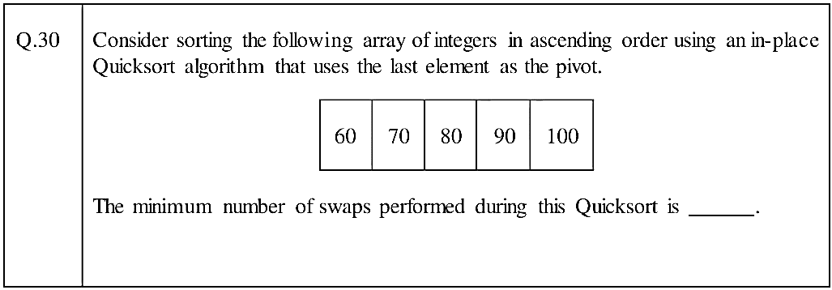
Gate DA -2024

Slide 43
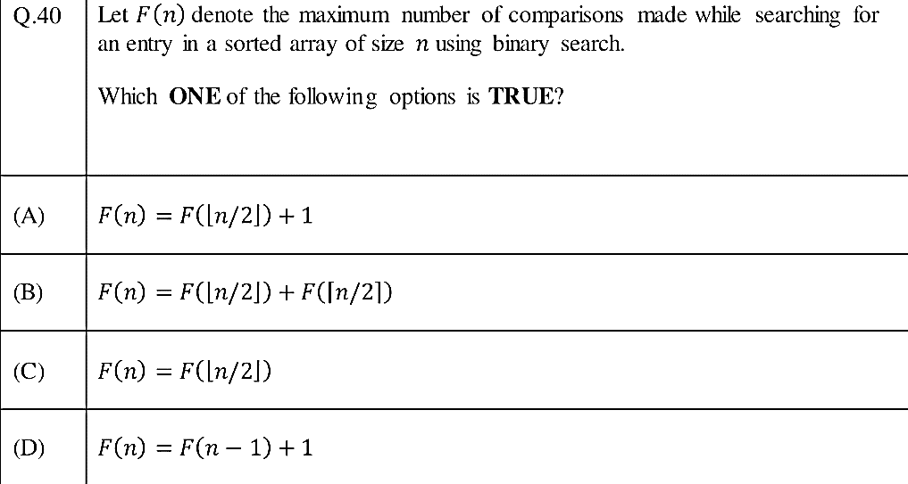
Gate DA -2024

Slide 44
Gate DA -2024

Slide 45
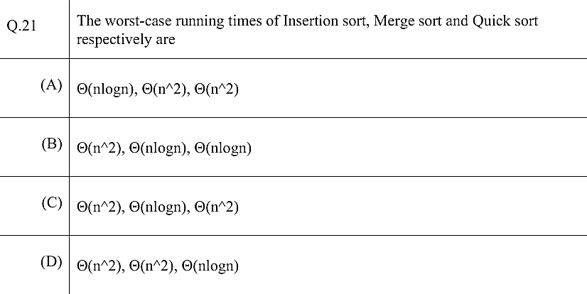
Gate DA –2024
Sample Paper

Slide 46
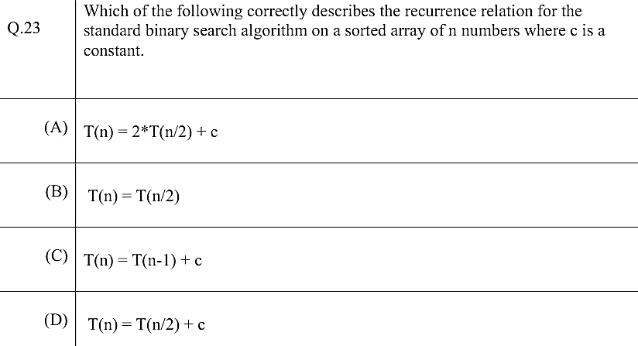
Gate DA –2024
Sample Paper

Slide 52

Any question?

